Slide 1
CERTIFIED DATA SCIENTIST
PEOPLE INFORMATION TECHNOLOGY PROGRAM
Lecture 03
Muhammad Nabeel Ibrahim Khan
NED University of Engineering and Technology

Slide 2
Agenda
Product Approach
Data Science Portfolio
Job Market for Data Scientists

Slide 3

Group Activity – Brainstorming Project Ideas
Think of a simple data science project.
What problem does the model solve?
How will the user interact with it?
How will you deploy the model?

Slide 4
What is the Product Approach?
Students often focus on building models, but in industry, the focus is on turning models into products that solve business problems.
Data science products are often integrated into apps, websites, or tools that non-technical users can interact with.
The goal is to make your models useful for people or businesses by building applications around them.
In product development, your model might need constant updates and improvements based on user feedback.

Slide 5









Tools to Help You Productize
Streamlit: A framework for turning Python scripts into interactive web applications.
Flask/Django: Python web frameworks to build and deploy data science models as web apps.
Heroku/Google Cloud/AWS: Platforms to deploy and host your models and applications.
Docker: Use Docker to containerize and deploy your models easily across environments.

Slide 6
Building a Data Science Portfolio
A data science portfolio is a collection of projects that showcase your skills, experience, and expertise in solving real-world problems using data science techniques.
Why Build a Portfolio?
  Employers look for proof of practical experience beyond just certifications. A portfolio shows that you can apply your skills.
  Your portfolio can include various skills like data wrangling, visualization, machine learning, and even deployment of models as apps.
  It encourages you to build and learn through hands-on projects, demonstrating growth over time.

Slide 7
Example
Data Science Portfolio
https://www.kaggle.com/discussions/general/272441

Slide 8
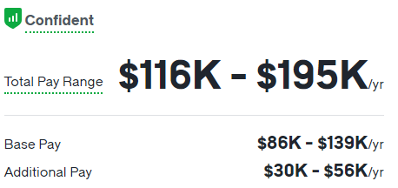
Job Market for Data Scientists
Data Scientist
Data Scientists study complex datasets to extract meaningful insights, helping organizations make data-driven decisions.
Key Responsibilities:
  Collecting and processing large datasets.
  Building predictive models to solve business problems.
  Visualizing data to communicate insights.
  Working with stakeholders to address their data needs.
Required Skills:
  Strong programming skills (Python, R).
  Expertise in statistical analysis and visualization tools.
  Knowledge of machine learning algorithms and data preprocessing techniques.

Slide 9
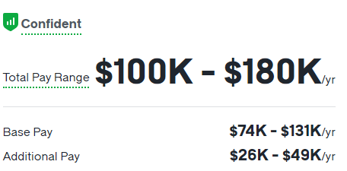
Job Market for Data Scientists
Machine Learning Engineer
Machine Learning (ML) Engineers develop and implement ML models that enable machines to learn from data and make predictions or decisions.
Key Responsibilities:
  Designing and developing algorithms for data analysis and prediction.
  Implementing supervised, unsupervised, and reinforcement learning models.
  Evaluating and optimizing model performance.
  Collaborating with data scientists to integrate ML solutions into products.
Required Skills:
  Experience with ML frameworks such as TensorFlow and PyTorch.
  Strong grasp of statistics and linear algebra.

Slide 10
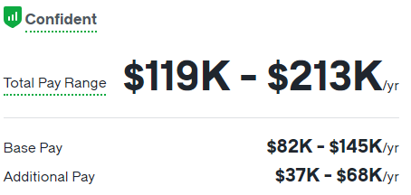
Job Market for Data Scientists
AI Research Scientist
AI Research Scientists push the boundaries of AI through cutting-edge research and experimentation. They often work in academia or research labs, contributing to advancements in the field
Key Responsibilities:
  Researching to explore new AI methods and techniques.
  Publishing research papers and presenting at conferences.
  Collaborating with teams to apply research to real-world problems.
Required Skills:
  Advanced degree (usually a Ph.D.) in computer science, AI, or related fields.
  Strong background in mathematics, including calculus, probability, and statistics.
  Proficiency in AI frameworks and programming.

Slide 11
Job Market for Data Scientists
AI Ethicist / Compliance Officer
AI Ethicists ensure that AI systems are designed and used ethically. They help organizations navigate the ethical and societal implications of AI technologies.
Key Responsibilities:
  Evaluating the ethical implications of AI technologies.
  Developing guidelines for responsible AI use.
  Conducting risk assessments and suggesting mitigations for ethical concerns.
Required Skills:
  Strong background in ethics or philosophy.
  Understanding of AI technologies and their societal impact.
  Excellent communication and analytical skills.

Slide 12
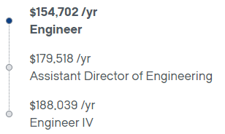
Job Market for Data Scientists
MLOps Engineer
MLOps Engineers ensure that machine learning models are effectively deployed and maintained in production environments, automating key processes for model deployment and monitoring.
Key Responsibilities:
  Implementing CI/CD (continuous integration/continuous delivery) pipelines for ML models.
  Monitoring model performance and automating retraining.
  Ensuring scalability and reliability of ML systems.
Required Skills:
  Strong understanding of DevOps tools and practices.
  Experience with cloud platforms (AWS, GCP, Azure) and ML frameworks.
  Proficiency in containerization technologies (e.g., Docker, Kubernetes).

Slide 13
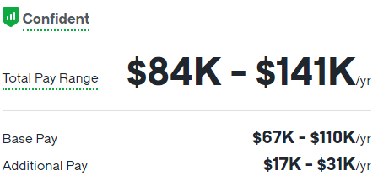
Job Market for Data Scientists
Data Engineer
Data Engineers design and manage the data infrastructure, ensuring that data is reliable, accessible, and ready for analysis.
Key Responsibilities:
  Building and maintaining data pipelines.
  Ensuring data quality and reliability.
  Collaborating with data scientists to understand data requirements.
Required Skills:
  Proficiency in SQL and database management systems.
  Experience with big data technologies (Hadoop, Spark).
  Strong programming skills (Python, Java).

Slide 14
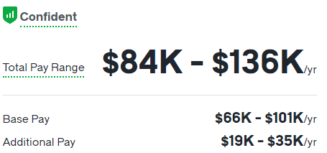
Job Market for Data Scientists
Business / Data Analyst (AI)
Business Analysts identify opportunities for AI implementation to improve business processes and efficiency.
Key Responsibilities:
  Analyzing business operations to identify AI-driven improvements.
  Gathering and documenting requirements for AI projects.
  Evaluating the impact of AI solutions on business performance.
Required Skills:
  Expertise in analysis and visualization tools (e.g., Tableau, Power BI).
  Excellent communication skills for working with stakeholders.

